Slide 1

CREDIT CARD FRAUD DETECTION
USING ANOMALY CLASSIFIERS
Prerna Singh (2000290100104)
Khyati Singla (2000290100082)
Prince Piyush (2000290100106)
Supervisor - Ms. Bharti (Assistant Professor)
Department – Computer Science and Engineering
KIET Group of Institutions, Ghaziabad, Delhi NCR

Slide 2
OUTLINE
i.
ii.
iii.
iv.
v.
vi.
vii.
viii.
ix.
Introduction
Anomaly Detection
Benchmark Dataset
Data Preprocessing
Resampling
Classification Models
Evaluation Metrics
Implementation and Results
References

Slide 3
INTRODUCTION
Credit card fraud constitutes a type of identity theft wherein a third party illicitly acquires an individual's credit card details for unauthorized purchases or misappropriation of funds.
Machine learning plays a crucial role in detecting credit card fraudulent transactions due to its ability to analyze vast amounts of data, identify patterns, and make predictions.
Unsupervised machine learning is advantageous for detecting credit card fraud as it autonomously identifies hidden patterns making it more adaptable to emerging fraud schemes.

Slide 4
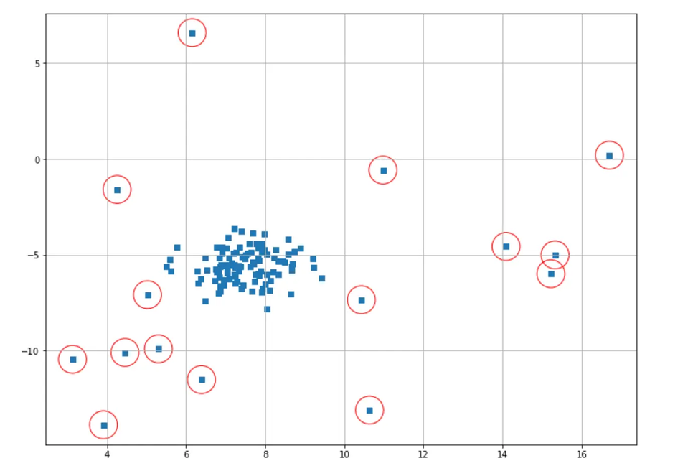
ANOMALY DETECTION
Anomaly Detection is the technique of identifying rare events or observations which can raise suspicions by being statistically different from the rest of the observations.
It is further divided into categories as -
(i) Supervised Anomaly Detection
(ii) Semi-Supervised Anomaly Detection
(iii) Unsupervised Anomaly Detection

Slide 5
BENCHMARK DATASET
The datasets used for research and analysis are collected from -
European Dataset :
German Dataset :
kaggle.com/europeancreditcardfraud
kaggle.com/germancreditcardfraud
Dataset | Total Instances | Normal Transactions | Fraudulent Transactions
European Credit Card Dataset | 2,84,807 | 2,84,315 | 492
German Credit Card Dataset | 1,000 | 700 | 300

Slide 6
DATA PREPROCESSING
Check for missing values in the dataset.
Check for duplicate instances.
Check for imbalance class in the dataset.
Perform Standardization.
Convert categorical variables into numerical formats.

Slide 7
RESAMPLING
Resampling techniques mitigate the impact of class imbalance by modifying the dataset distribution, preventing models from being biased towards the majority class.
01
02
03
Undersampling
Oversampling
Combination
Random Undersampling
AllKNN
SMOTE
SMOTE-ENN

Slide 8
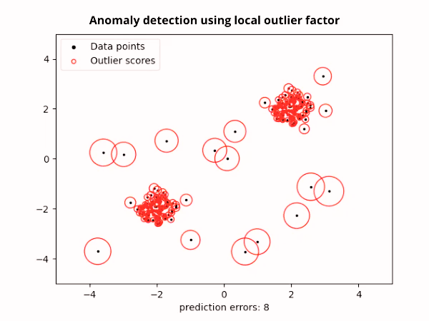
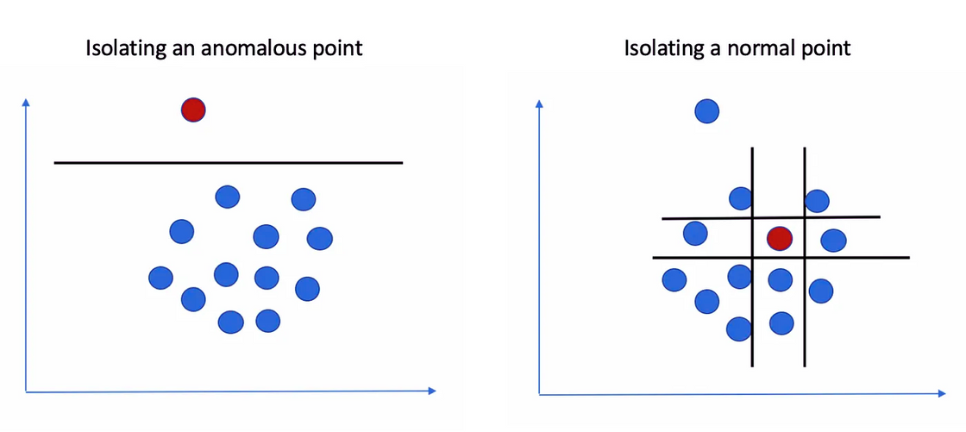
CLASSIFICATION MODELS
The anomaly detection classifiers implemented are -
Isolation Forest - It uses binary trees to find outliers, employing an ensemble method averaging predictions for anomaly scores.
Local Outlier Factor - It calculates a data point's local density deviation from neighbors, generating an anomaly score for outliers.

Slide 9
EVALUATION METRICS
Specific metrices were used to check how well the anomaly classifiers were performing such as –
Accuracy : (TP + TN ) / (TN +TP + FN + FP)
Precision : TP / (TP + FP)
Recall : TP / (TP + FN)
F1-score : 2 * ((Precision * Recall) / (Precision +Recall))
Number of Outliers

Slide 10






IMPLEMENTATION AND RESULTS
Table 1 : Results of models implemented on imbalanced dataset
Dataset | IF Classifier | LOF Classifier
European Dataset
German Dataset
Table 2 : Most effective approach for each dataset
Dataset | Most Effective Approach | Accuracy %
European Dataset | IF Classifier
German Dataset | LOF – Random Undersampling
Published Research Paper - P. Singh, K. Singla, P. Piyush and B. Chugh “Anomaly Detection Classifier for Detecting Credit Card Fraudulent Transactions”, 2024 Fourth International Conference on Advances in Electrical, Computing, Communication and Sustainable Technologies (ICAECT), Bhilai, India, pp 1-6, IEEE, 2024

Slide 11
REFRENCES
Gupta, Swati, Sanjay Patel, Surender Kumar, and Goldi Chauhan. ”Anomaly detection in credit card transactions using machine learning.” (2020)
Rajeev, Haritha, and Uma Devi. ”Detection of credit card fraud using isolation forest algorithm.” In Pervasive Computing and Social Networking: Proceedings of ICPCSN 2021, pp. 23-34. Springer Singapore, 2022
John, Hyder, and Sameena Naaz. ”Credit card fraud detection using local outlier factor and isolation forest.” Int. J. Comput. Sci. Eng 7, no. 4 (2019): 1060-1064
Itoo, Fayaz, Meenakshi, and Satwinder Singh. ”Comparison and anal?ysis of logistic regression, Na¨ıve Bayes and KNN machine learning algorithms for credit card fraud detection.” International Journal of Information Technology 13 (2021): 1503-1511.
Vijayakumar, V., Nallam Sri Divya, P. Sarojini, and K. Sonika. ”Isolation forest and local outlier factor for credit card fraud detection system.” International Journal of Engineering and Advanced Technology (IJEAT) 9 (2020): 261-265.

Slide 12
Thank You
Prerna Singh, Khyati Singla, Prince Piyush
KIET Group of Institutions, Ghaziabad, Delhi NCR

